Slide 1
T1A3 Terminal App
Ashlie Gray

Slide 2
T.P.R Tracker (Temperature, pulse & respiratory)
App designed to streamline the process of rounds in a vet hospital
Allows user track the vital signs on inpatients

Slide 3
Main Features
Login/create user profiles
Find /create patient profiles
Add log and enter temp, pulse and resp-rate of patient.
View the patient log that they or others have which is identified and time stamped.
Help menus, one that gives overall navigation help and another that presents normal values.

Slide 4
Code
Classes – User and Patient
Methods – add log, view log, title screen
Code heavily reliant on user input. Functions by user input that loops through program
Csv files used to store databases for users and patients
Csv file used to log input and present to screen in file
Gems – TTY Prompt, TTY Table, colorize

Slide 5
Development Process
Started with the idea, then how it would work with the control flow, determined the ‘parts’ I would need and how they would work together.
Challenges – putting the overall puzzle that was my code, together so it worked.
Ethical issues -
Favourite parts - Getting it to work

Slide 6
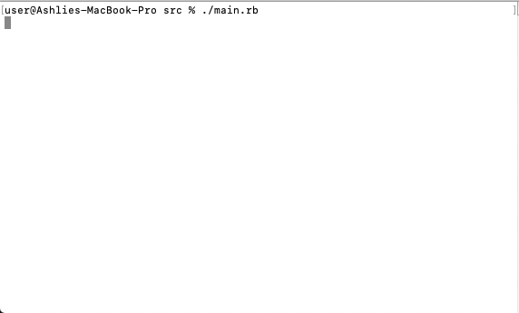
Preview

Slide 7

Thank you for listening!

